Slide 1
Computer Vision in Basketball
Identifying Players and Detecting Pick-and-Roll Plays

Slide 2
Overview
1. Introduction to Computer Vision
2. Identifying Basketball Players
3. Understanding Pick-and-Roll Plays
4. Implementation Workflow
5. Tools and Technologies
6. Summary and Next Steps

Slide 3
Introduction to Computer Vision
Computer Vision enables machines to interpret and make decisions based on visual data.
Object detection
Pose estimation
Action recognition
Applications in sports analytics are growing rapidly!

Slide 4
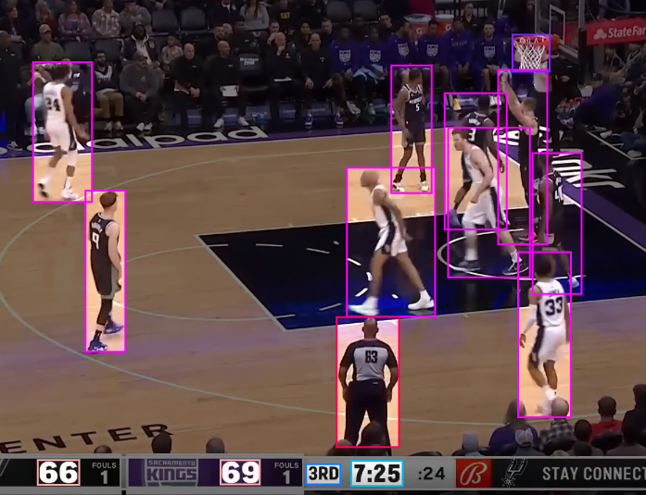
Identifying Basketball Players
Using Object Detection Models:
- Detect players using bounding boxes
- Classify teams based on uniform colors or logos
Popular models: YOLO, Faster R-CNN, Detectron2

Slide 5
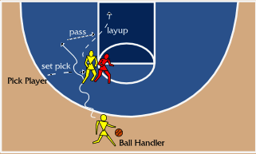
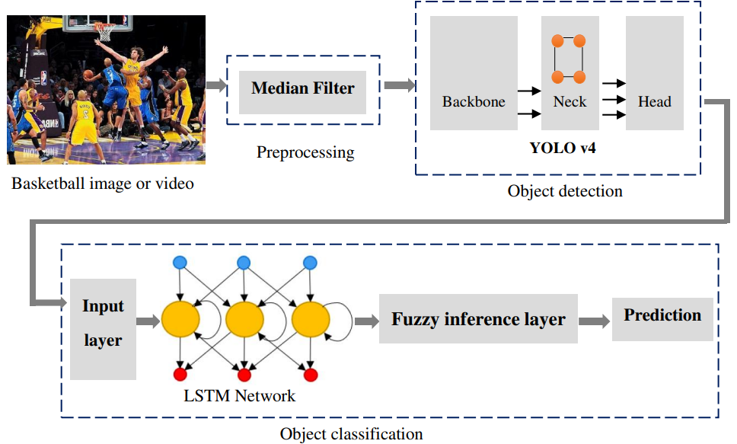
Understanding Pick-and-Roll Plays
Key elements:
- Pick (Screen): A player blocks the path of a defender.
- Roll: The screener moves toward the basket.
Computer Vision Tasks:
- Detect interaction between players
- Analyze movement patterns
- Recognize specific actions

Slide 6
Implementation Workflow
1. Data Collection and Annotation:
- Game footage, player bounding boxes, action labels
2. Player Detection and Tracking:
- Detect players, classify teams, track movements
3. Pose Estimation and Action Recognition:
- Analyze body keypoints and classify pick-and-rolls
4. Event Detection:
- Integrate outputs to identify plays

Slide 7
Tools and Technologies
1. Object Detection:
- YOLO, Faster R-CNN, Detectron2
2. Pose Estimation:
- OpenPose, Mediapipe, HRNet
3. Tracking:
- DeepSORT, ByteTrack
4. Action Recognition:
- SlowFast, TimeSformer
5. Frameworks:
- PyTorch, TensorFlow

Slide 8
Summary and Next Steps
Summary:
- Computer Vision can enhance sports analytics.
- Detecting pick-and-rolls requires combining detection, tracking, and action recognition.
Next Steps:
- Collect annotated basketball footage.
- Train models for detection, pose estimation, and action recognition.
- Deploy and test the system.

